Slide 1
CSCI 1101 Introduction to Computer Science
What is computer science
and
A [Brief] history of computers and computing

Slide 2
What is computer science?
Computer Science is the study of computer systems including hardware and software.
Unlike computer engineers who deal with hardware and software, computer scientists focus mainly on software (programs) and software systems (which includes their theory, design, development, and application). This requires them to solve from abstract problems (like determining if a problem can be solved with a computer and, if it is, discovering the algorithm that will solve it) to concrete problems like creating a web site, installing and maintaining a network, designing and implementing a device driver, etc.
As a CS student you will learn not only programming languages, but how to design computer systems, how people interact with computers, how to handle large amounts of information, how to build networks, create websites, computer animation, robotics, and much more.
Notes:
<number>

Slide 3
Computer Science
As a discipline
What can be efficiently automated?
Necessary skills
Design solutions
Algorithmic thinking
Data Representation
Programming
Discipline:
A field of study.
A branch of knowledge, typically one studied in higher education.

Slide 4
Terminology
Algorithm: A set of steps that defines how a task is performed
Program: A representation of an algorithm
Programming: The process of developing a program
Hardware: Equipment; the physical elements of the system
Software: Programs and algorithms
Abstraction: a mental model that removes complex details

Slide 5
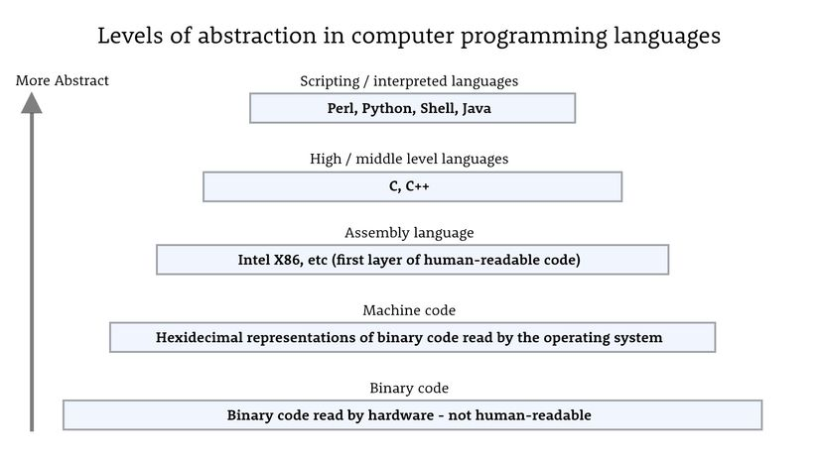
Abstraction

Slide 6
“Hello, World!” in High-Level Languages

Slide 7
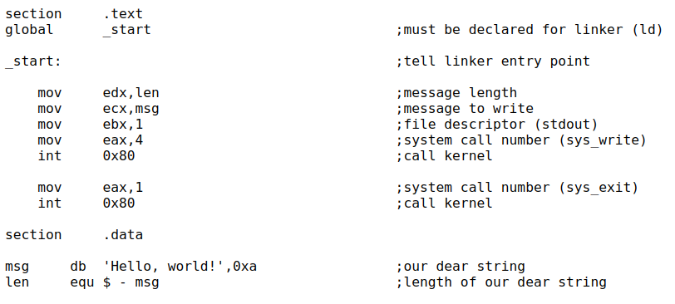
“Hello, World!” in Assembly

Slide 8
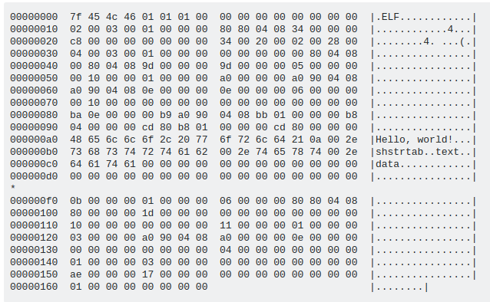
“Hello, World!” in Machine Code

Slide 9
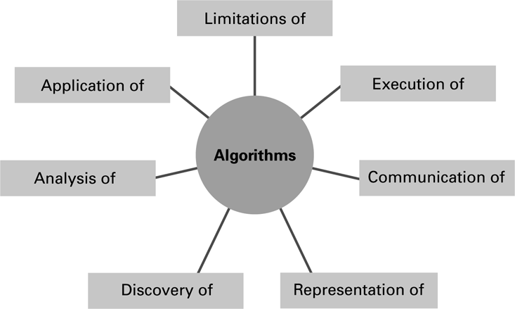
The Role of Algorithms in CS
Algorithms play a central role in the discipline of computer science

Slide 10
Systems Areas and Application Areas
Systems: Helps manage computer system
Applications: Get stuff done
Algorithms and Data Structures
Programming Languages
Architecture
Operating Systems
Software Engineering
Human-Computer Communication
Numerical and Symbolic Computation
Databases and Information Retrieval
Intelligent Systems
Graphics and Visual Computing
Net-Centric Computing
Computational Science

Slide 11
History of the Computer
http://www.history.com/shows/modern-marvels/videos/who-invented-the-computer
http://www.computerhistory.org/timeline/?category=cmptr

Slide 12
Early (not electronic) Computing Machines
Abacus: positions of beads represent numbers
Gear-based machines: positions of gears represent numbers
Blaise Pascal: Pascaline, mechanical calculator
Joseph Jacquard: Jacquard’s Loom, inventor of punch card
Charles Babbage: Difference Engine, Analytic Engine
Ada Lovelace: first programmer, inventor of the loop

Slide 13
Key Things to Remember
Charles Babbage
The “Father” of the computer. Created the first mechanical computer.
Ada Lovelace
First programmer. Made programs for Babbage’s machine. Alan Turing
Alan Turing
The “Father” of modern Computer Science.

Slide 14
The “Generations” of Computing
Hardware and software innovations went hand in hand
Each “generation” is characterized by particular technology

Slide 15
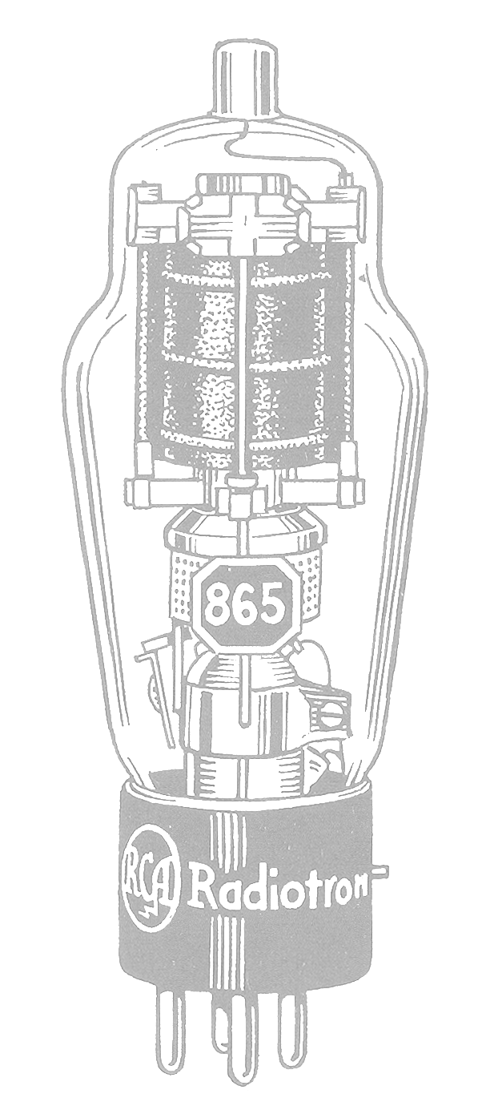
First Generation (1951-1959)
Hardware
Software
Mechanical relays (Harvard Mark I)
Vacuum tube (Colossus, ENIAC)
Magnetic drum
Magnetic tape drive
Earliest machine programs were hard wired
Machine language
Assembly language
Programmers already splitting into systems and applications

Slide 16
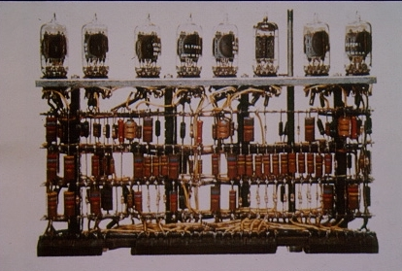
First Generation
http://minf.vub.ac.be/~marc/info-hecol/html/cu-02.html

Slide 17
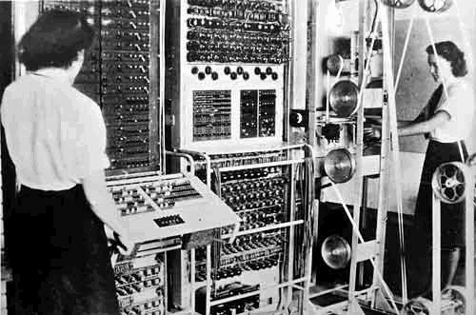
First Generation
Colossus, United Kingdom, 1944

Slide 18
Second Generation (1960-1965)
Hardware
Software
Transistors
Magnetic core memory
Magnetic discs
Introduction of high-level programming languages

Slide 19
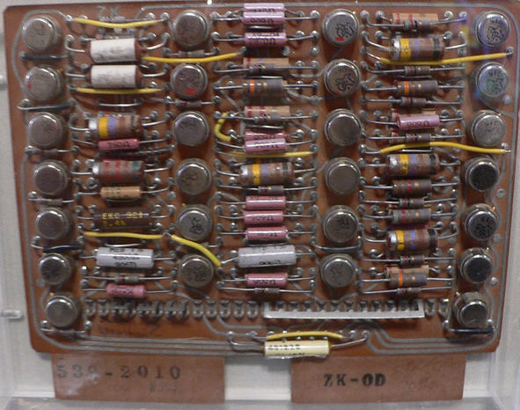
Second Generation
http://www.ganssle.com/tem/tem257.html

Slide 20
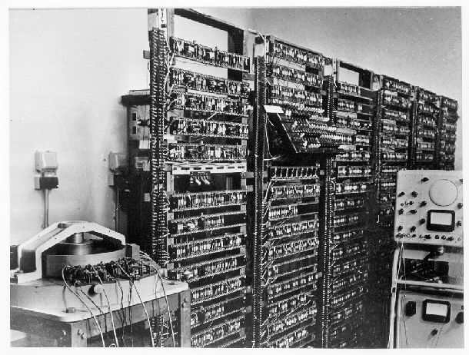
Second Generation
Manchester University Experimental Transistor Computer, 1953

Slide 21
Third Generation (1965-1970)
Hardware
Software
Integrated circuits
Transistors for memory
Terminal
Operating system
Increasing separation between user and hardware

Slide 22
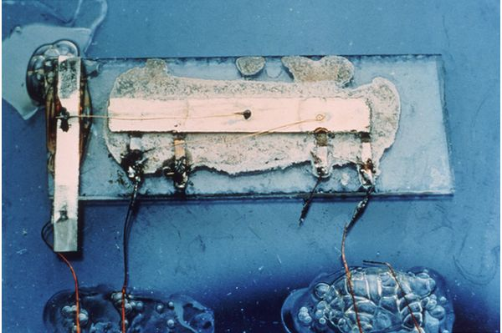
Third Generation
Jack Kilby’s original integrated circuit

Slide 23
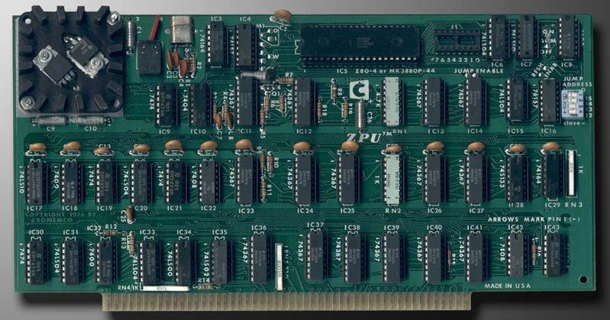
Third Generation
Cromemco, "ZPU" (4mHz Zilog Z80 CPU board) 1976
http://www.kuhmann.com/Cromemco/CrosNest.htm

Slide 24
Fourth Generation (1970 – 1990)
Hardware
Software
Advances in chip technology
Miniaturization and embedded circuits
Emergence of the personal computer
Introduction of networking
Proliferation of application software
Rapid growth of computer use

Slide 25
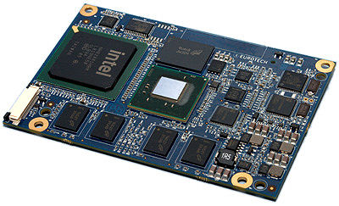
Fourth Generation
http://www.directindustry.com/prod/eurotech/cpu-boards-7026-846807.html

Slide 26
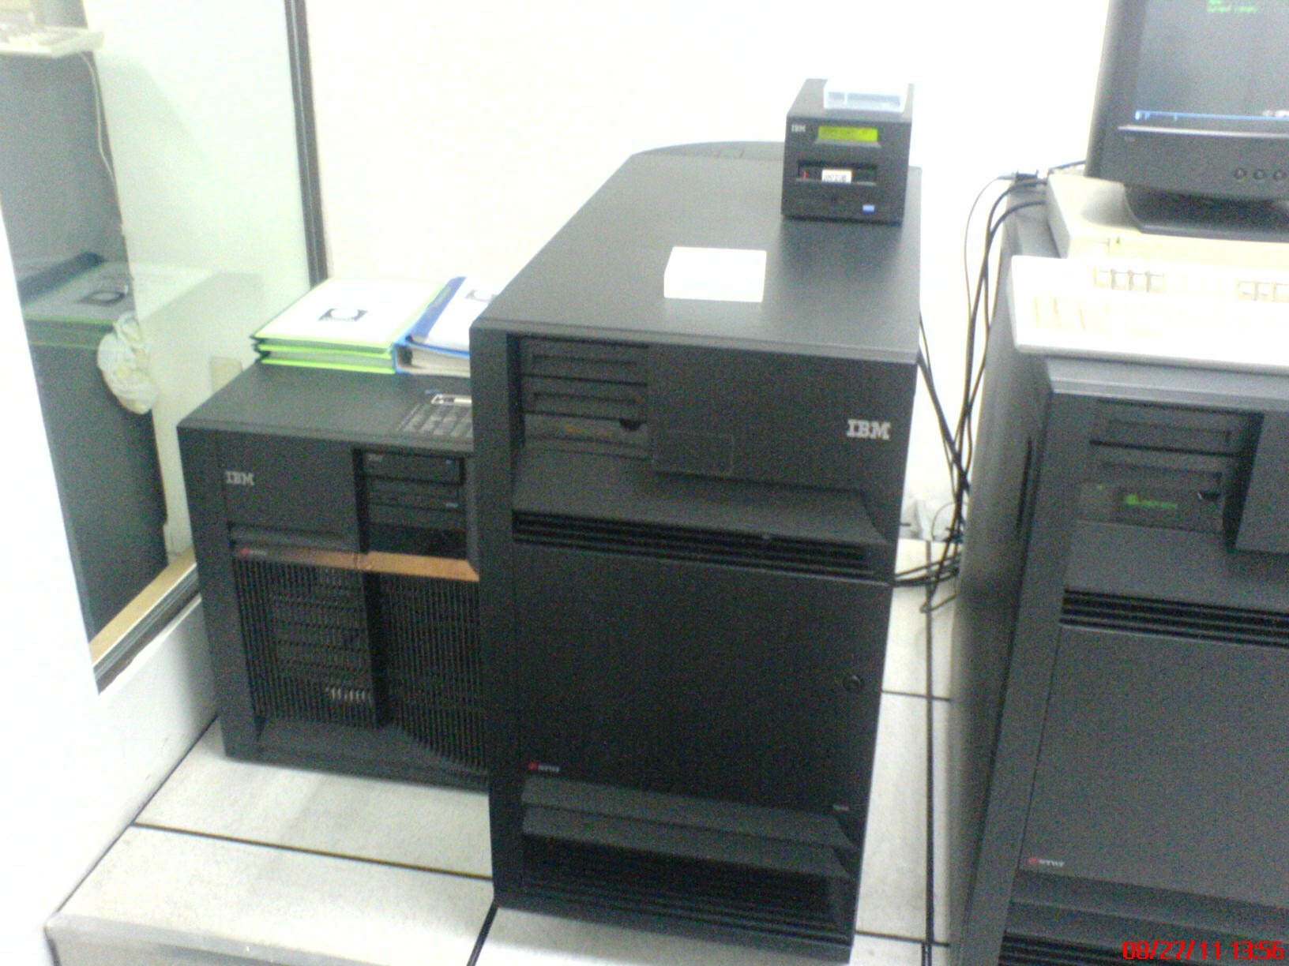
Fourth Generation
http://as400andmainframe.files.wordpress.com/2013/01/242995-gif.jpg

Slide 27
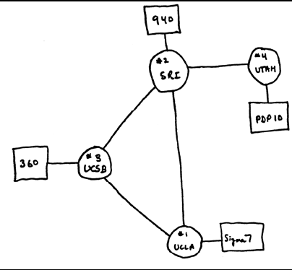
Fourth Generation
ARPANET: The beginnings of the Internet
Original: 4 nodes
Now: 500+ million nodes

Slide 28
Fifth Generation (1990-present)
Hardware
Software
Continued LSI and miniaturization
Mobile computing
Networking
Internet
World Wide Web
Object oriented design
Explosion of number of users

Slide 29
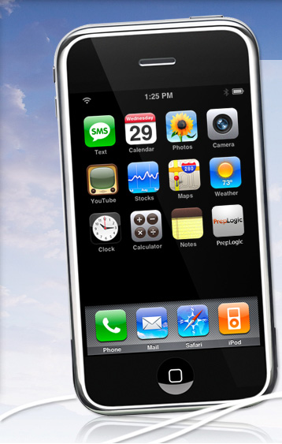
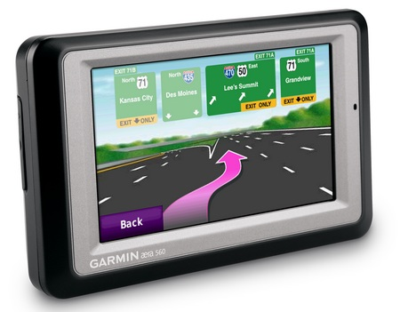
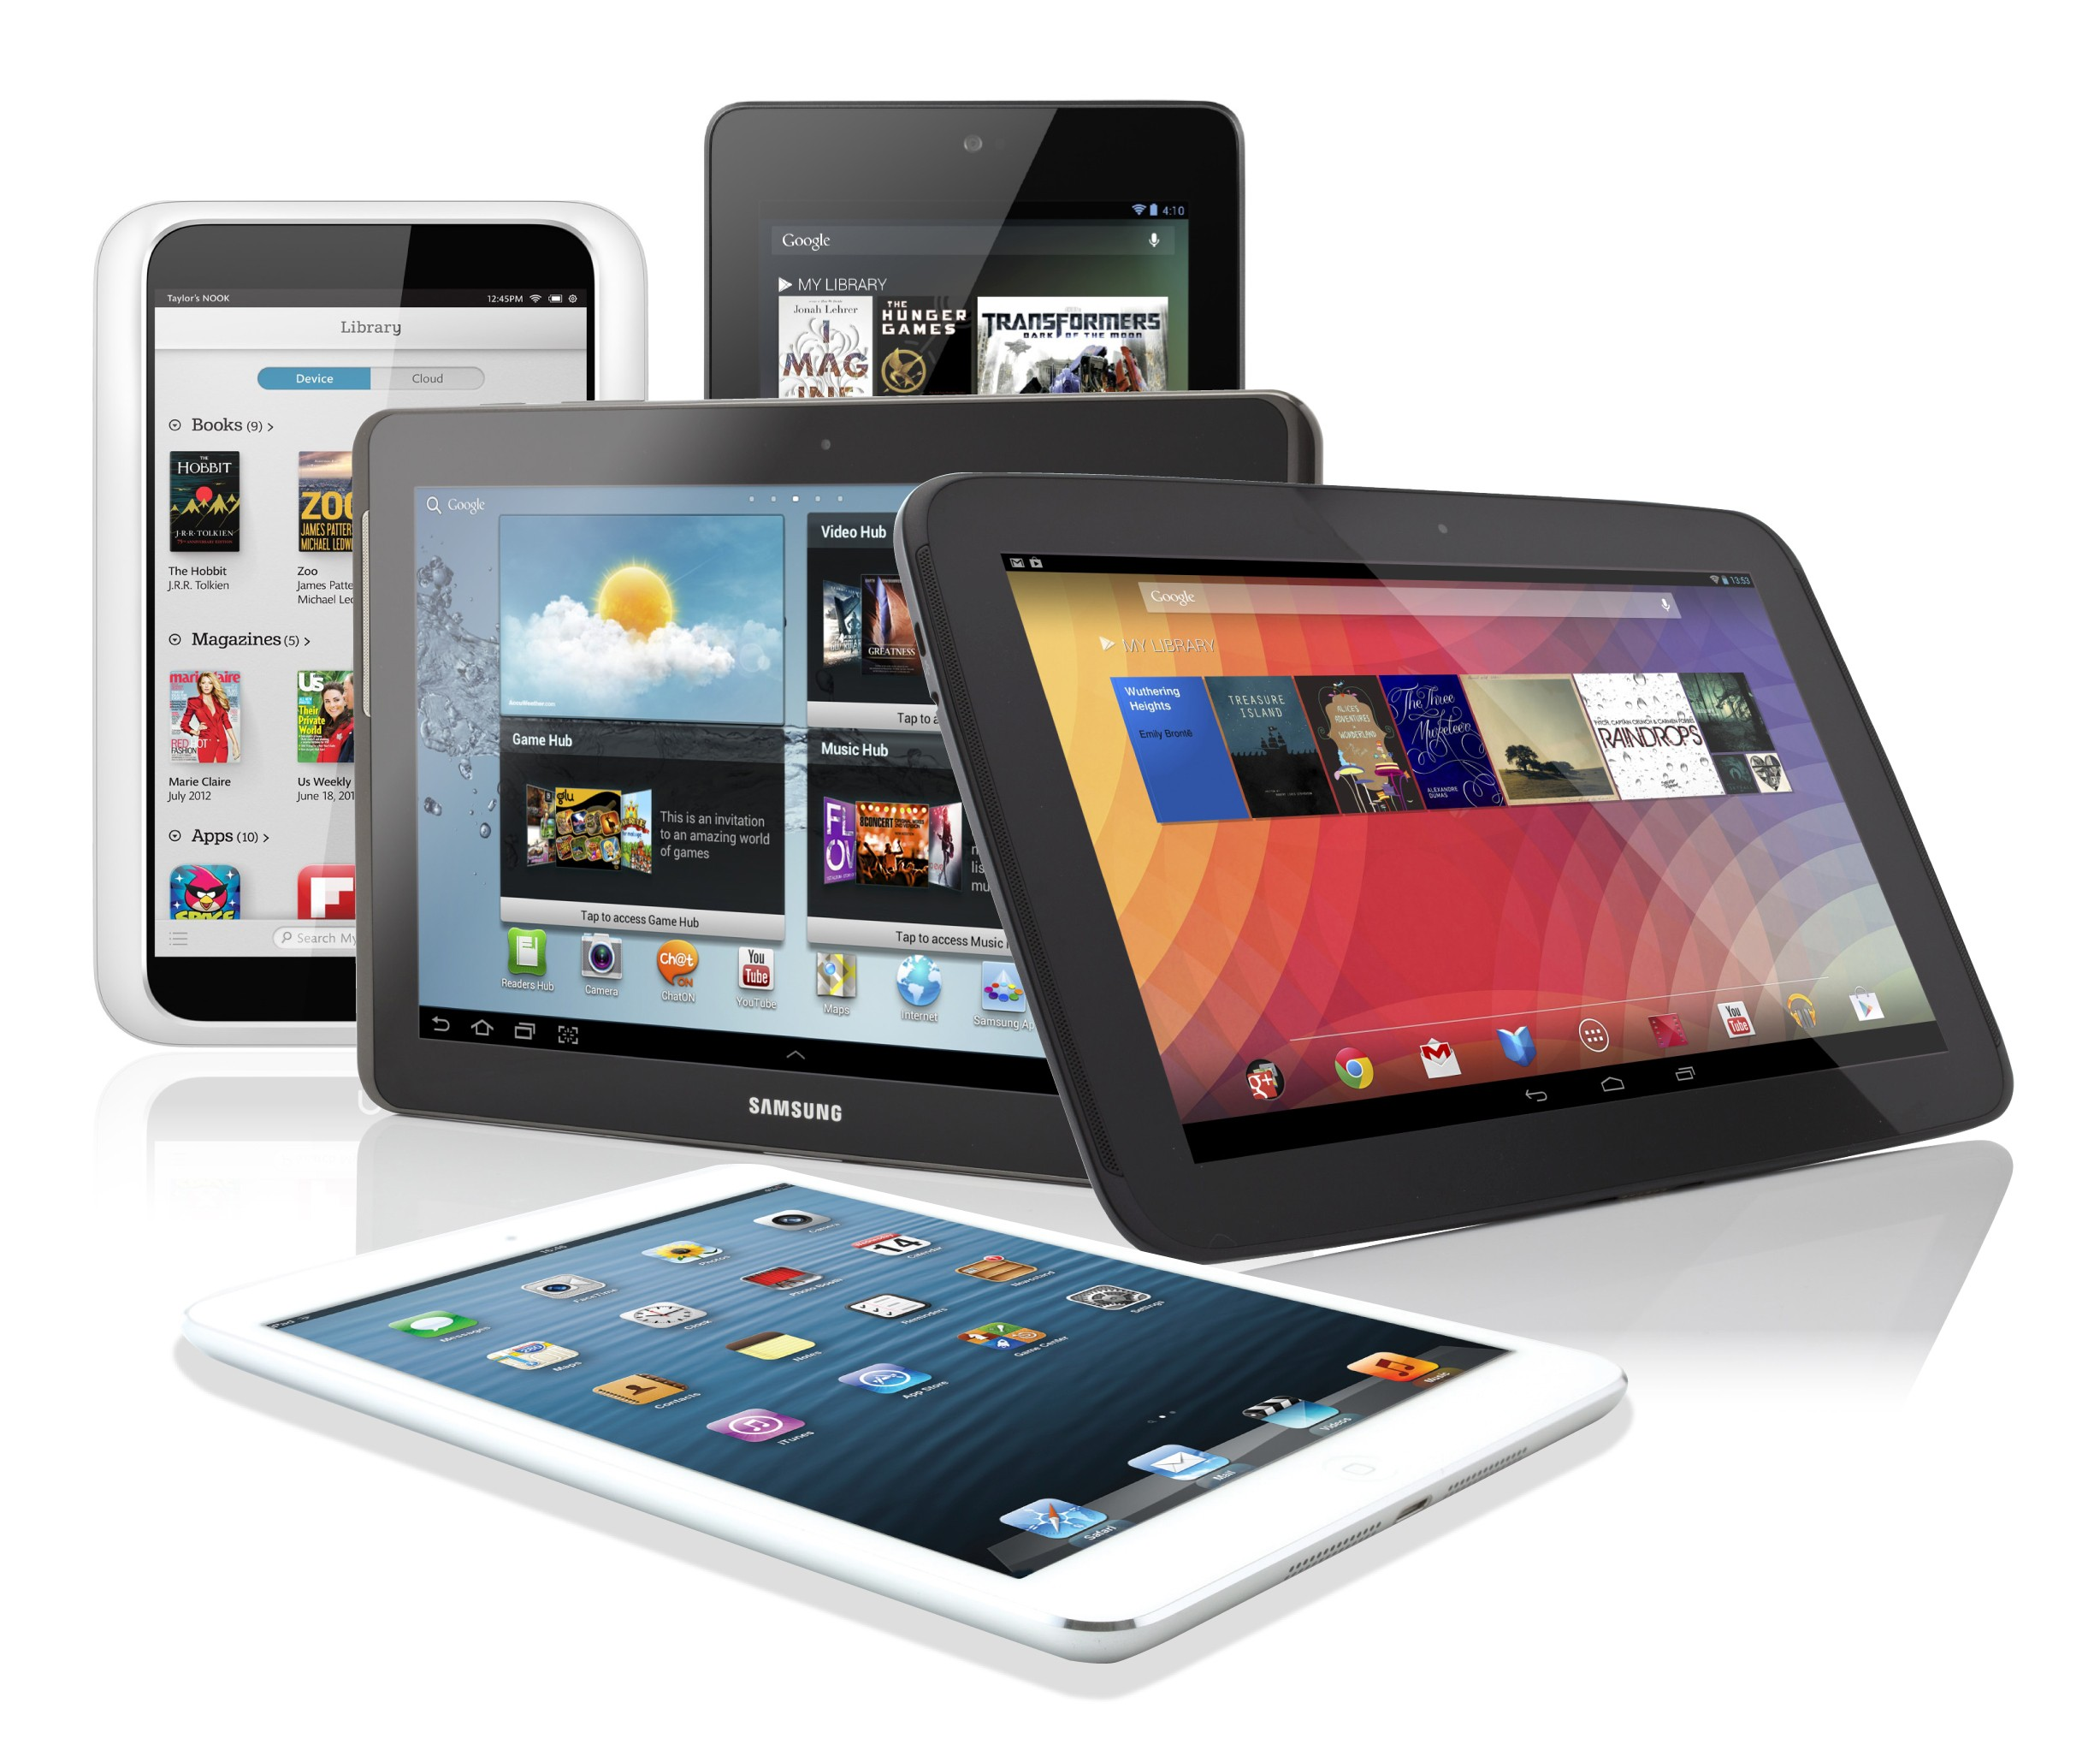
Fifth Generation
http://www.itechnews.net/2009/11/05/garmin-aera-series-handheld-navigation-devices/
http://bgr.com/tag/tablets/
http://www.learnsmartsystems.com/details/mobile.aspx

